Slide 1
Link Building
http://seocourse.telerik.com
Георги Моллов
georgimollov.tumblr.com
georgi.mollov@gmail.com

Slide 2
What is Link?
<a href=“www.SITE.com”>SITE</a>
Anchor text = SITE
Link Title
<a title=“SITE” href=www.site.com>SITE</a>
JavaScript линк

Slide 3
Type of Links
Text links
Nofollow ☺
Image links
Alt=“…..”

Slide 4
Value of the Link
Top (good value)
Left (good value)
Content (good value)
Right (low spam)
Footer (high spam)
top
left
content
right
Bottom

Slide 5
How to Measure the Link Value?
Page Authority
Social Share
Links to this page
Links out from this page
Website Trust
Website owner
Website neighbors
Website links total

Slide 6
How to Measure the Link Value? (2)
Page relevancy to topic
Anchor text in Title
Position of the link
IP address of the site – “C” class network different from our
213.213.122.12 – 213.213.156.15

Slide 7
Easy Links
Social links
Short Links (twitter, bit.ly)
Web 2.0 links
Profile links
Directory links
Widget links
Template Links
Article Links
News directory links / Press Releases

Slide 8
What is Your Link Profile?
Your links against the Competitors links
Number of links
Linking pages/website Location
Linking pages Authority / Site trust
What types of sites are these links from?
Are they manually building these links? (directories, articles, guest blogging)

Slide 9
What is Your Link Profile? (2)
Your links against the Competitors links
Do they appear to be paid?
What's the IP address and WHOIS information or anything fishy?
What strategy is working here? Or is there even a strategy?
Where are they getting the branded and name links?
What communities are they participating in?

Slide 10
Getting Links
Check your competitors then make a plan examine the competitors link profile.
See if you can get links from the same pages
Try to be creative
Invest time and money

Slide 11
How to Trace Links?
http://ahrefs.com/
http://www.opensiteexplorer.org/
http://www.majesticseo.com
And many more

Slide 12
How? & If? We are Buying or Building Links
Check the Site – (opensiteexplorer.com)
Whois – Site.com
Check the IP of the site then (bing – ip:IPofTheSite)
web.archive.org/ - domain history
http://www.copyscape.com – copied content
Google index – site:http://www.Site.com/someurl.html

Slide 13
How? & If? We are Buying or Building Links (2)
Anchor text – don’t over do (разгледайте нишата!!!)
http://www.site.com – this is link too
People usually link with the <H1> tag
Link velocity or link speed

Slide 14
Useful Resources
FireForm
Google Global
LinkDiagnosis.com
SEO contests – аквичоп, ипотпал
Check top 5 see what they have done

Slide 15
Discover Links with Google
site:bg intitle:"добави сайт“
intitle:"директория" site:bg
intitle:"директория за статии" site:bg
социална мрежа
Платформи за безплатни сайтове (сателити)

Slide 16
To Read
http://slides.bg/546/ - Калин Каракехайов
http://svejo.net/tag/линк билдинг/all
http://socialevo.net/pet-tehniki-za-link-bilding-za-balgarski-saytove-42394
http://www.seomoz.org/blog/guide-to-competitive-backlink-analysis

Slide 17
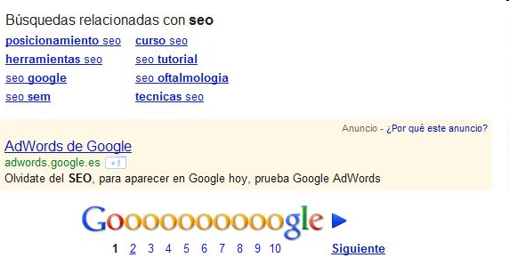
Why SEO Is So …
“Forget about SEO. To be visible in Google today, try Adwords”
http://www.iloveseo.net/dear-google-why-do-you-want-me-to-hate-you/

